Slide 1
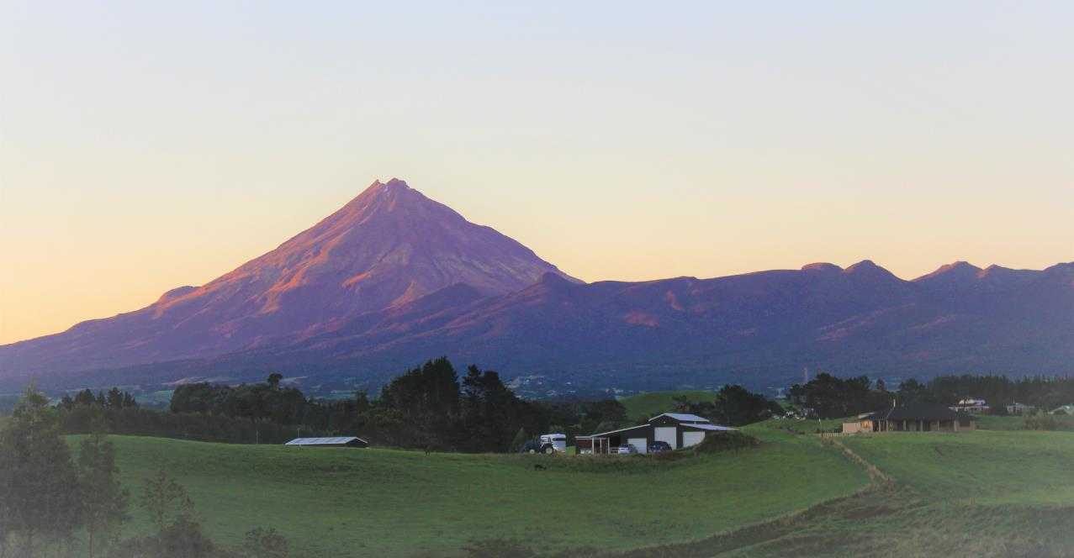
TARANAKI CATCHMENT
COMMUNITIES

Slide 2
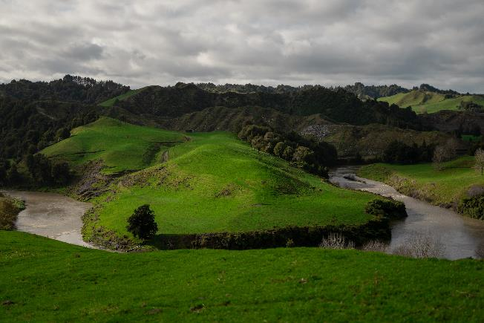
WHAT IS A CATCHMENT COMMUNITY GROUP?
A group of people, working together, in a geographical area, usually centered around a river or lake catchment
People who connect socially within a rural community

Slide 3
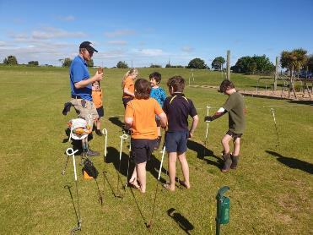
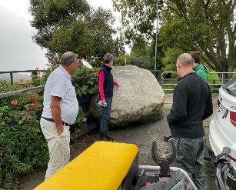
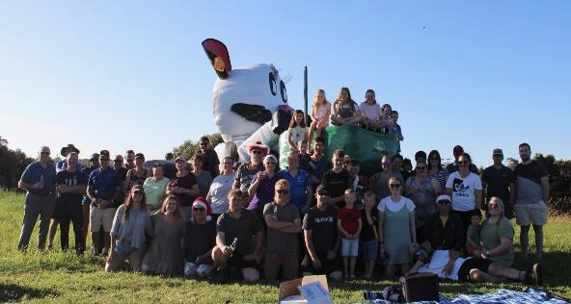
TCC INCORPORATED
Vision: Flourishing rural communities
Mission: To empower and connect catchment communities
Membership: Leader from each individual catchment group community, plus representation from Federated Farmers, Venture Taranaki and Taranaki Young Farmers
Current Management Committee: Donna Cram, Jo Gibbs, Jarred Coogen, Murray Perkes, Katrina Knowles, and Ross Dunlop, with Chris Harvey and Ryan Stockman supporting. We manage administration of funding on behalf of the individual catchment communities. Each community has its own budget.
Project Lead and Co-ordinators

Slide 4
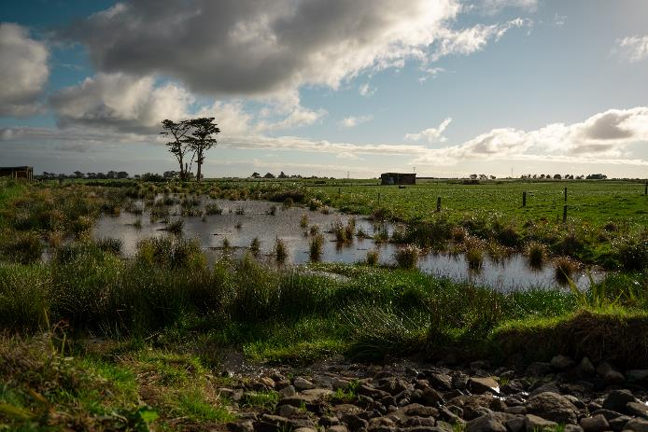
BACKGROUND
Discussions began with interested farmers and Venture Taranaki at the start of 2020
Need for the rural sector to respond to upcoming legislative change and changing customer demands
A farmer-led, farmer driven, ground up approach will support and empower farmers to ensure the long-term sustainability of their communities.
Support by an initial $50k MPI grant as part of the Sustainable Land Use programme and then a further $1.25m over two years to June 2023.

Slide 5
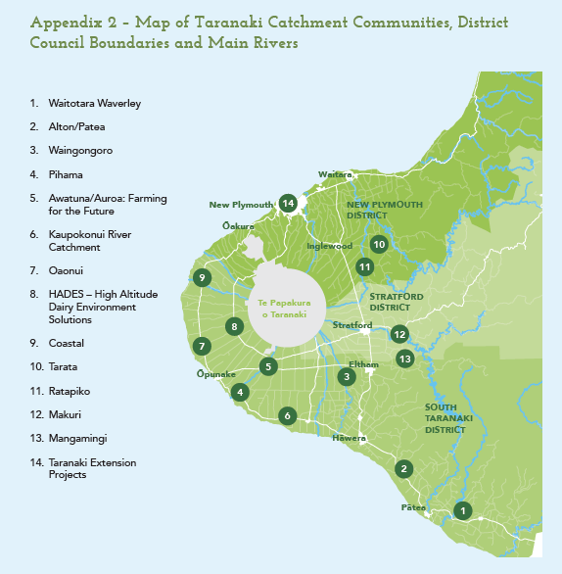
TARANAKI CATCHMENT COMMUNITY GROUPS
Formalised 15 catchment groups around the Maunga, 4 mostly beef and lamb communities and 11 mainly dairy.
Established one region-wide working group to focus on extension projects i.e. financial literacy.
Interest from a further three or four groups to set up catchment community groups at a later stage.
New group added in Urenui/Mimi/Uruti
Starting planning for Waiongana Catchment group

Slide 6
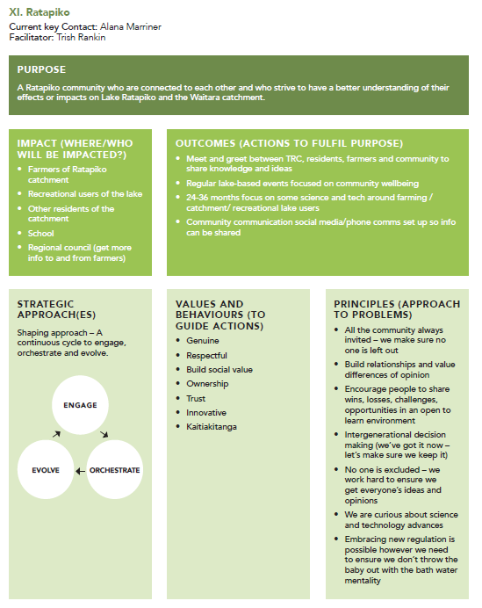
COMMUNITY ENGAGEMENT
Taranaki has a very diverse landscape, each with it’s own challenges. Each community has different needs and aspirations.
The Project Co-ordinator worked with each individual catchment group to understand and assess their challenges and opportunities.
Each catchment group answered four questions to develop their own ‘strategy on a page’
What strengths does our community already have?
What are the challenges we need to navigate?
What are the opportunities out there to investigate?
If I could do anything for our community I would…

Slide 7
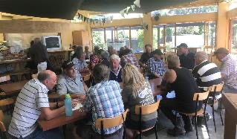
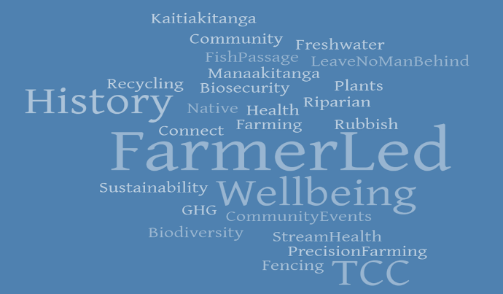
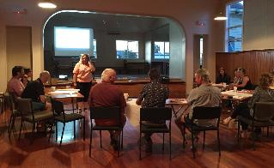
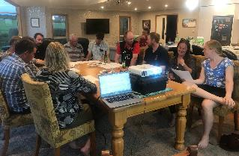
WHAT WE HEARD
Everyone involved during initial engagement showed great care for their people, their community, their community’s future, the environment and looking after their land

Slide 8
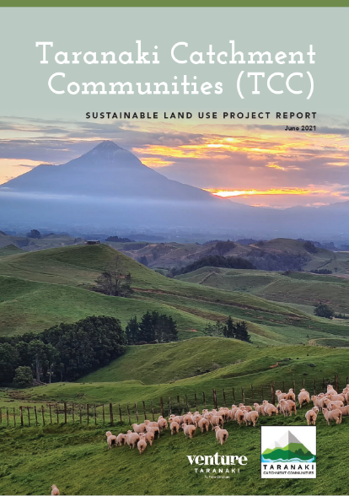
PROJECT REPORT
Initial MPI funding enabled us to develop a 2 year Sustainable Land Use project – this ended in June 2023
This was the result of:
More than 2,100 farmers attending community meetings
8,000+ hours voluntary work
Establishment and development of key relationships with community groups, local authorities, industry bodies and Iwi
Report available online in full on Venture Taranaki website

Slide 9
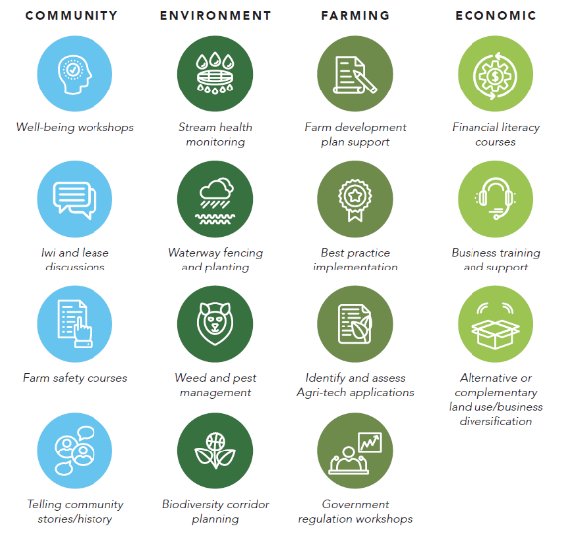
FORWARD WORKPLAN
The individual catchment community group strategies feed into a region wide workplan
This workplan grouped together meaningful and practical actions together under four key areas of focus:
Community
Environment
Farming
Economic

Slide 10
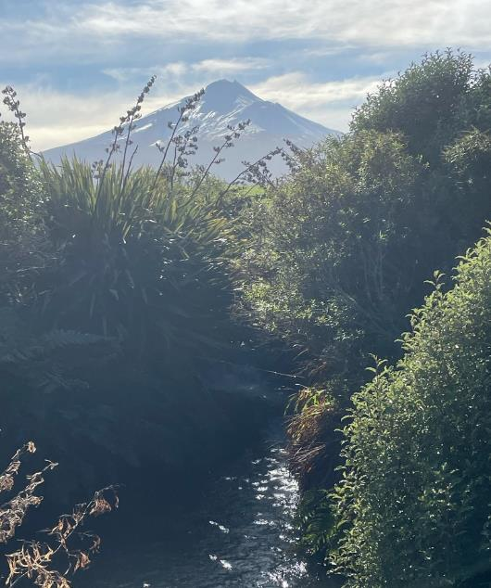
WHAT HAVE WE DONE?
Pest trapping plan for Tarere Extension in Patea
Freshwater health reports for all catchment groups
Technology monitoring program trial – Water2Milk
Well Being presentations around the region with Paul Rangiwahia
An Agri-kids program has been running at Auroa School for most of the past year. Coastal School is starting this year.
For the High Altitude Dairy Environment Solutions Group (HADES) Element’s Matt Highway has completed a report on solutions.
Presentations on the ETS. This is a real issue especially for the Sheep and Beef communities.
LiDAR modelling has been started to show critical source areas – this is a Taranaki wide project
We have had three first aid courses in the winter with more coming up. These have been tailored to a rural setting
We have had social functions – part of well being and important for engagement and bringing communities back together
Become the liaison between the rural community and Ag professionals
Region wide survey commissioned on the rural community regarding IFP
Notes:
Fish passage
Lake Herengawe project
Collaboration video

Slide 11
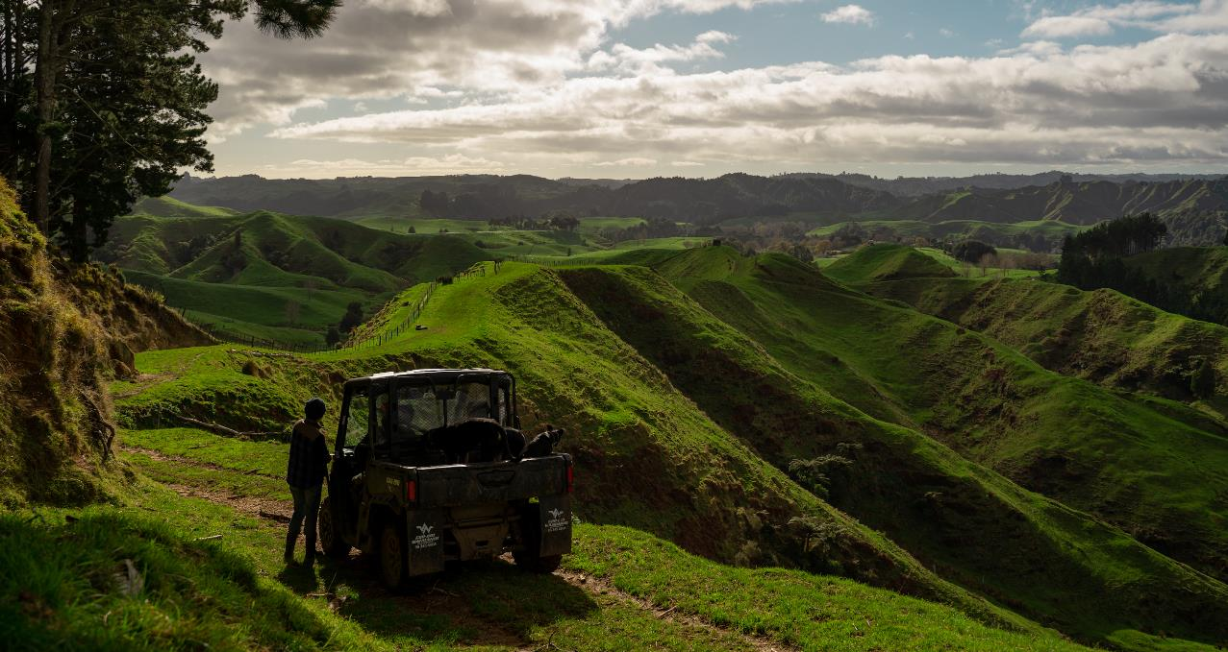
Where to next?
MPI Essential Freshwater project – 2 years
MPI Integrated Farm Planning project – 3 years
Engagement of a communications strategy specialist – need to raise awareness

